Slide 1
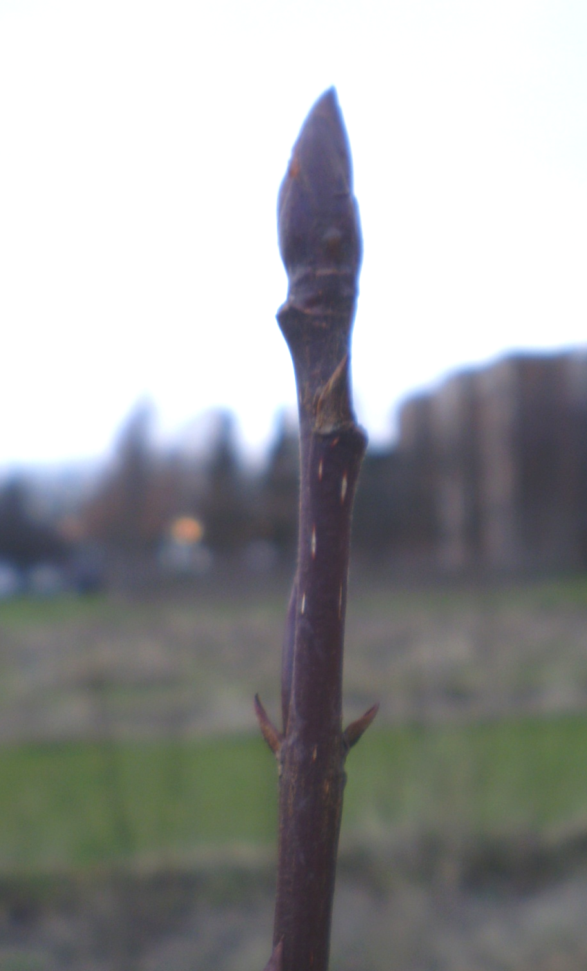
Stage 0
Dormant
Photo: Shofi Azam

Slide 2
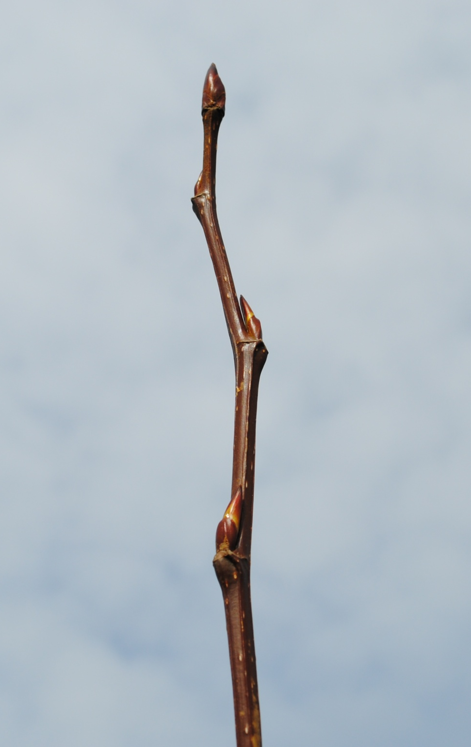
Stage 1
Bud swelling
(still dormant)
Photo: Shofi Azam

Slide 3
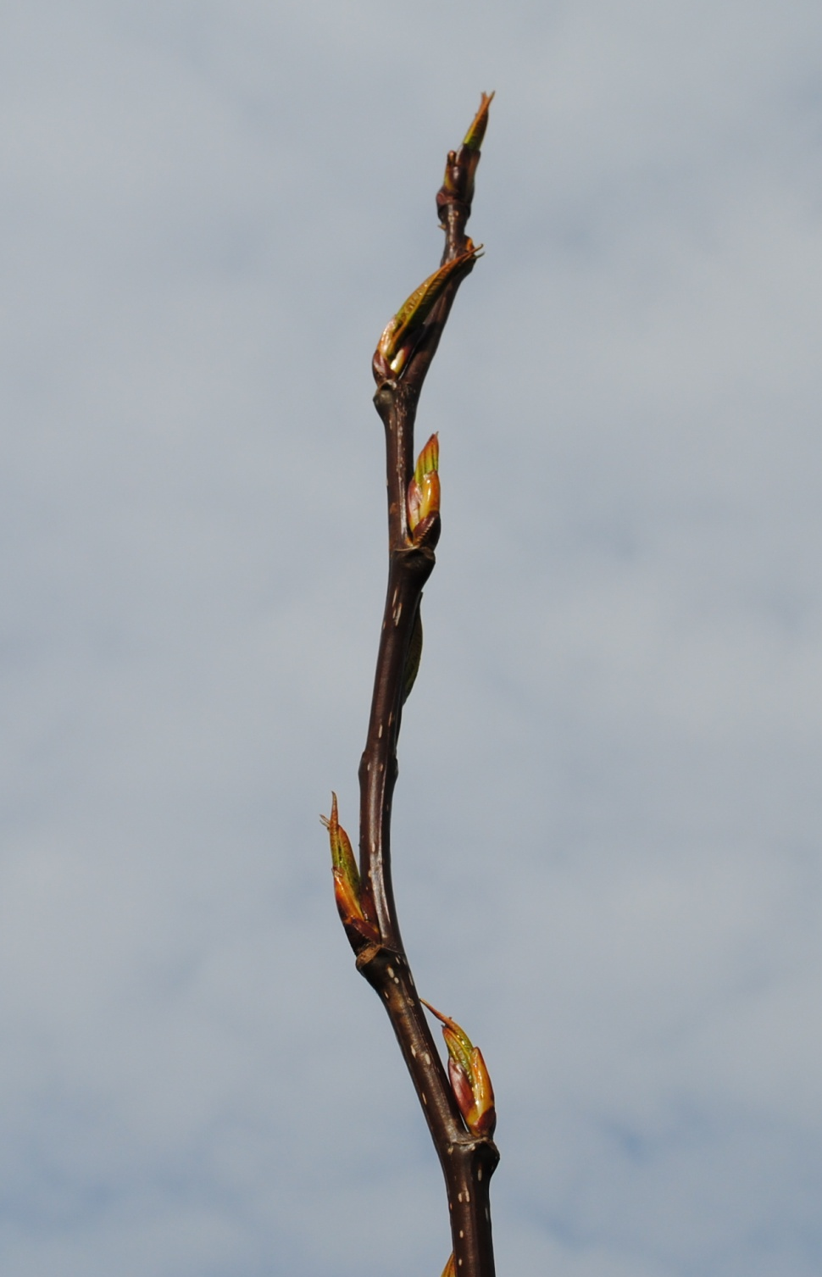
Stage 2
Green tips
Photo: Shofi Azam

Slide 4
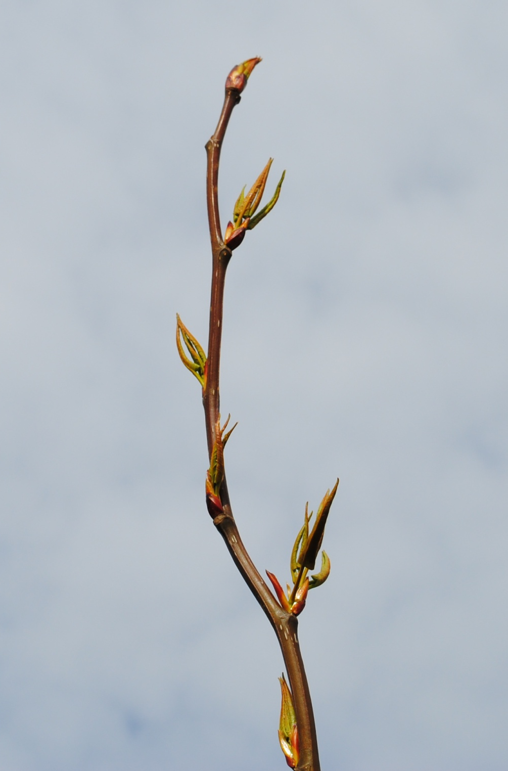
Stage 3
Bud flush
Photo: Shofi Azam

Slide 5
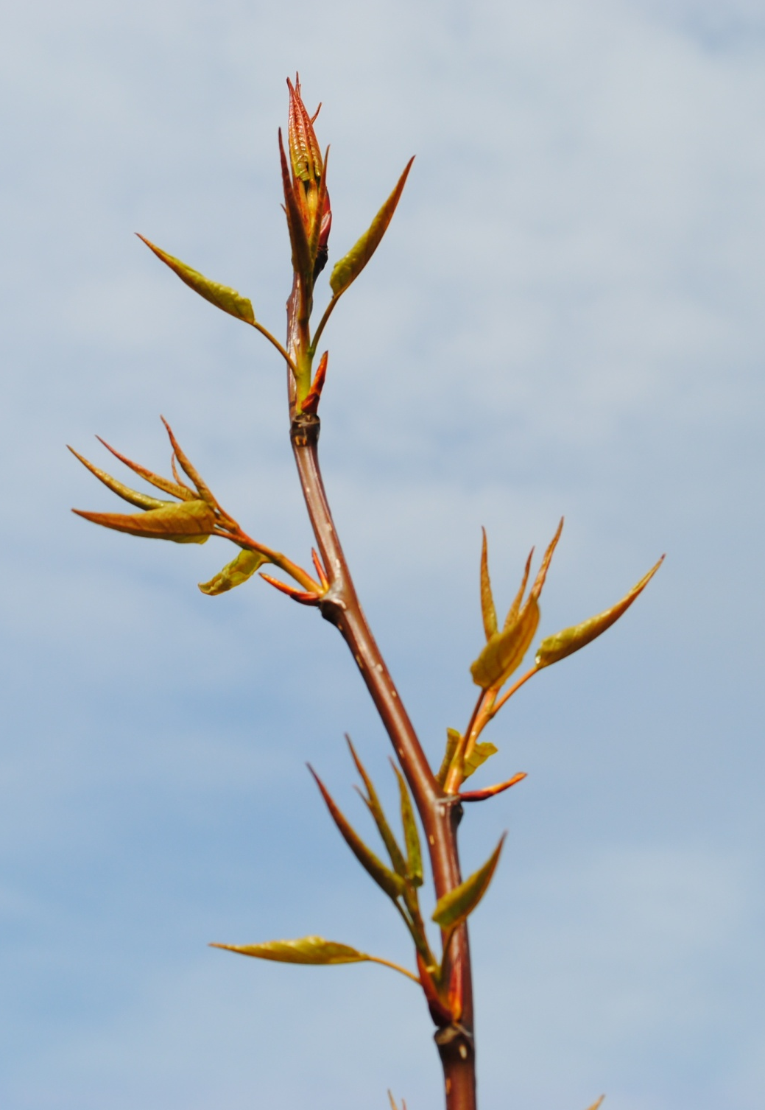
Stage 4
Leaf unfolding
Photo: Shofi Azam

